Slide 1
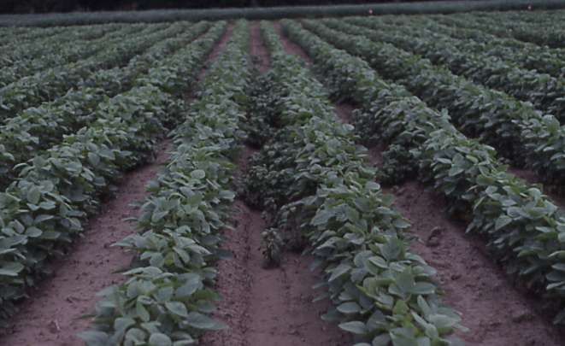


Changes in Soil Microorganisms by Glyphosate
ROBERT J. KREMER
USDA-ARS & UNIVERSITY OF MISSOURI
COLUMBIA, MO
“Standard” field trials conducted with Roundup Ready soybean.
Field trial on Tiptonville silt loam, Pemiscot County, Missouri 1999

Slide 2
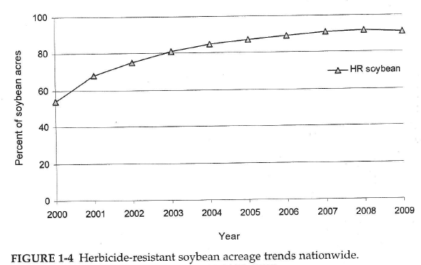
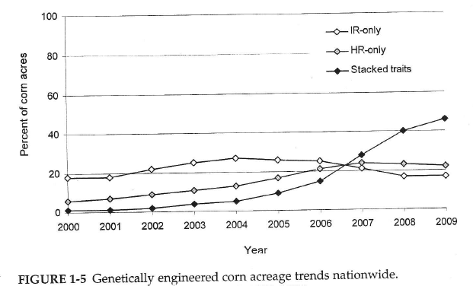
U.S. GR Soybean Acreage
Glyphosate is most widely used herbicide in agriculture
U.S. GM Corn Acreage
Source: National Research Council. 2010. The impact of genetically engineered crops on farm sustainability in the United States. National Academies Press, Washington DC.

Slide 3
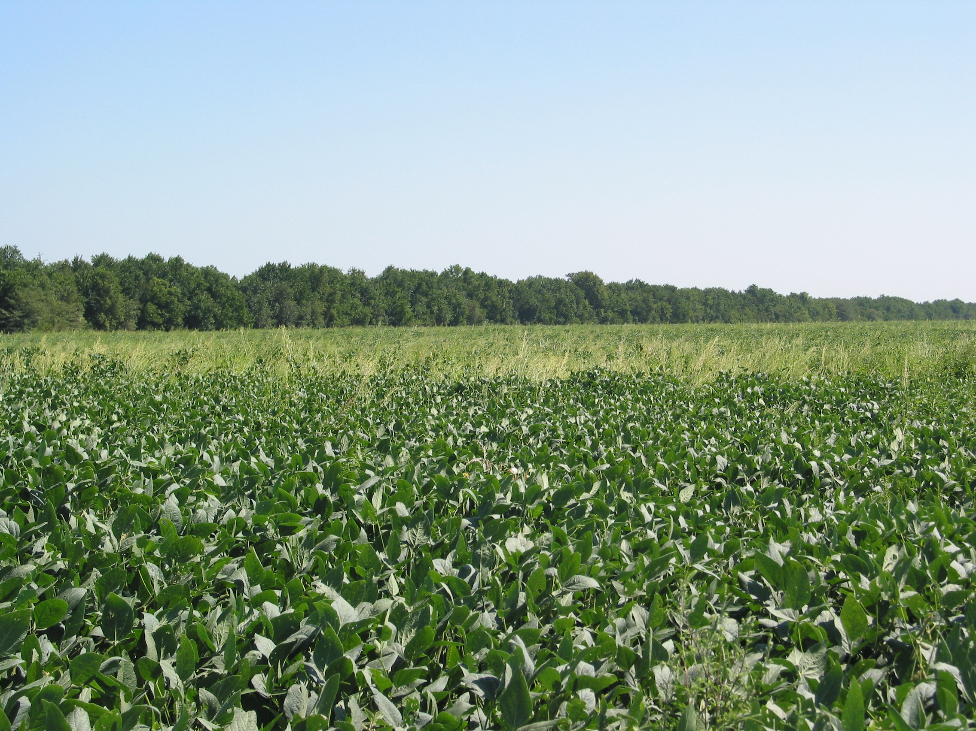
Glyphosate and Glyphosate-Resistant Crops (‘Roundup-Ready’ [RR] Production System)
Advancement in effective weed management (despite the development of glyphosate-resistant weed biotypes)
Alterations in microbial ecology and biology of the rhizosphere environment may occur affecting:
  Nutrient cycling (plant availability)
  Potential phytopathogen and antagonist balance
  Composition & activities of beneficial microorganisms

Slide 4
Some current concerns regarding glyphosate and glyphosate-resistant crops
Glyphosate accumulates in plant tissues including root, shoot, reproductive organs
Some applied glyphosate exudes from roots into soil
Glyphosate can be desorbed from soil by applied phosphorus
Glyphosate complexes with nutrients; reduces availability for plant growth
Residual glyphosate in soil can damage desirable plants by root uptake
Stimulates soilborne pathogens and other soil microorganisms reducing nutrient availability
Reduces photosynthesis
Reduces nitrogen fixation
Increases drought stress
Reduces mineral contents of seeds
Increases mycotoxins in vegetative and reproductive tissues
Generally results in ‘yield drag’ in glyphosate-resistant varieties compared with isogenic parent plants
Glyphosate is non-selective for weed control; also non-selective within plant in immobilizing plant nutrients
Transgenic plant DNA (cp4 EPSPS gene) released by GR plant into soil
Adapted from Huber (2010) and Gulden & Swanton (2007)

Slide 5
Regardless of the merits of current concerns of glyphosate and glyphosate-resistant (GR) crops, the attention gained has increased awareness of the importance of a total management system including:
Complete plant nutrient program for healthy crop growth
Holistic assessment of GR cropping systems:
  Consider above-ground growth AND soil-root complex
  Understand plant – root – soil – microorganism environment
  Understand plant – herbicide – soil – microorganism interactions
  Understand how management affects this environment and the complex interactions

Slide 6
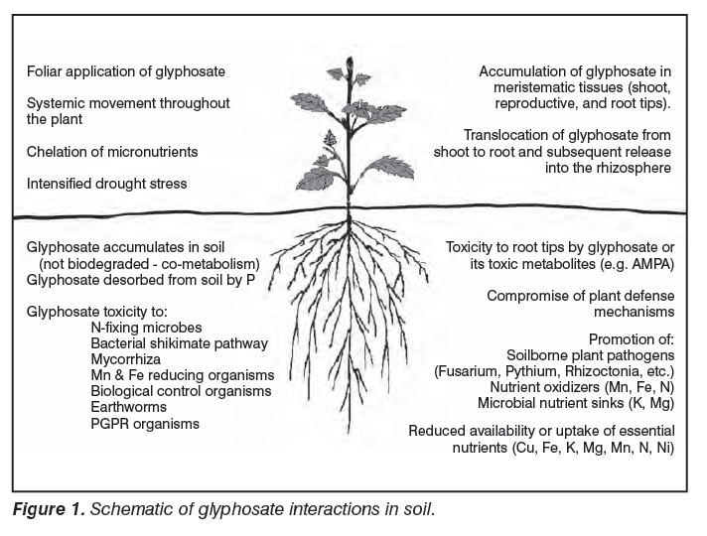
Holistic view of plant-soil-microorganism complex to better understand and sustainably manage crop production system
Modified from Huber (2010)

Slide 7

Properties of Glyphosate
Chemical – strong chelator of metal cations (nutrient immobilization; glyphosate inactivation) (Subramaniam & Hoggard 1988)
Biochemical – blocks aromatic amino acid synthesis by inhibiting the key enzyme, 5-enolpyruvylshikimate-3-phosphate synthase (EPSPS), in the shikimic acid pathway, common to plants, algae, and microorganisms; synthesis of proteins, lignin, phytoalexins, plant growth regulators, signaling compounds are suppressed (Johal & Huber 2009, Steinrücken & Amrhein 1980)
Biological – may stimulate or inhibit growth of specific microbial groups – may be consequence of 1 & 2 above (Kremer et al. 2005, Krzysko-Lupicka & Orlik 1997, Moorman et al. 1992)
M^{+n}

Slide 8
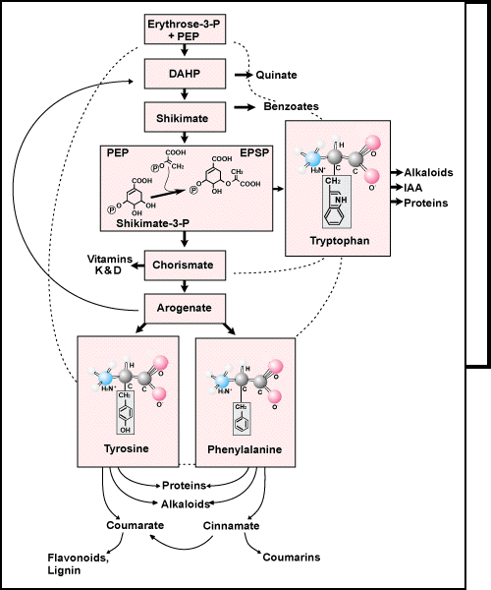
Primary carbohydrate metabolism
Glyphosate
Plant-growth regulators
EPSPS
Aromatic Amino Acids
Phytoalexins, signaling compounds, lignin
plantandsoil.unl.edu
Notes:
This is the shikimate pathway. These are the 3 amino acids produced by the pathway - tryptophan, phenylalanine, and tyrosine
Glyphosate disrupts the pathway here. Inhibiting EPSPS synthase preventing the formation of EPSP
Disruption of EPSP synthase stops aromatic amino acid production and is lethal

Slide 9
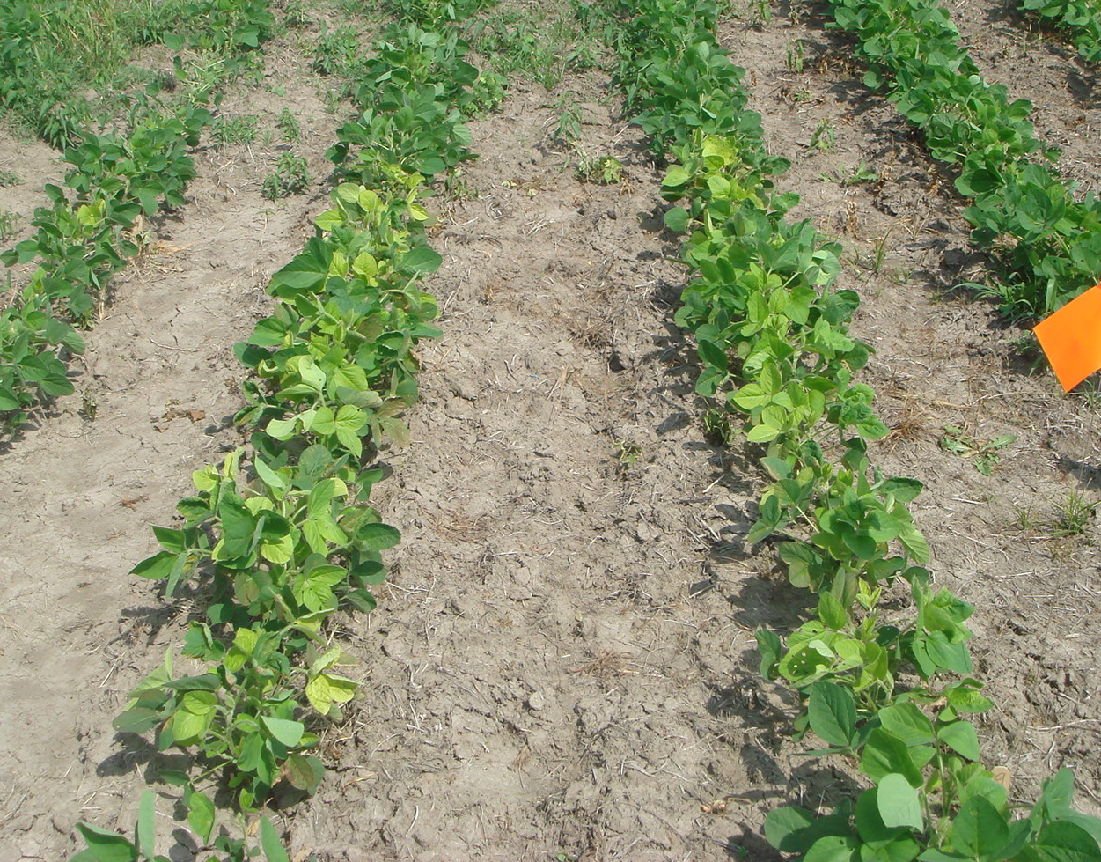
Chemical/Biochemical Effects: Yellowing of leaves in GR soybean after glyphosate application suggests unavailability of essential nutrients for chlorophyll development and photosynthesis
Chlorosis on Asgrow AG3539 soybean in field plots after glyphosate application at V4 growth stage, Boone County, MO 2009

Slide 10
Chemical properties of glyphosate have implications on plant nutrition and microbial function and interactions (– nutrient cycling and beneficial activities of microbes on behalf of plants)
Nutrients are essential to physiological and biochemical functions, many of which common to both plants and microorganisms
Nutrient elements | Biochemical/Physiological functions
C, O, H, N, S | Major constituents of organic substances (carbohydrates, proteins, lipids, enzymes)
P, Ca, B | Linkage of major polymers in cell walls and membranes (phospholipids, nucleotides; cellulose); energy transfer
K, Mg, | Cellular ion, pH balance; enzyme activation; photosynthetic activity
Mn, Fe, Cu, Zn, Mo, Ni | Activate/mediate numerous important enzymatic reactions in various metabolic pathways
Note: Deficiency or immobilization of an essential nutrient may affect one or more metabolic pathways yet have consequences on overall functioning of plant or microorganism

Slide 11
General summary of soil test results for Missouri soils where glyphosate-resistant soybean trials conducted, 1997-2010
Nutrient | Soil test values (range in ppm) | Sufficiency range (ppm)
P | 3.0 - 150 | 30 - 100
K | 35 - 295 | 150 - 350
Ca | 900 - 2000 | 400 - 2000
Mg | 120 - 340 | 100 - 300
Fe | 35 - 132 | 5 - 50
Mn | 8.5 - 72 | 8 - 50
B | 0 - 2.1 | 0.5 - 10
Cu | 0.15 - 2.8 | 1.0 - 12
Zn | 0.04 - 18 | 3.0 - 20
Mo | 0 - 1.78 | 0.2 - 0.5
Ni | 0 - 0.4 | 0.1 - 0.5 (est.)

Slide 12
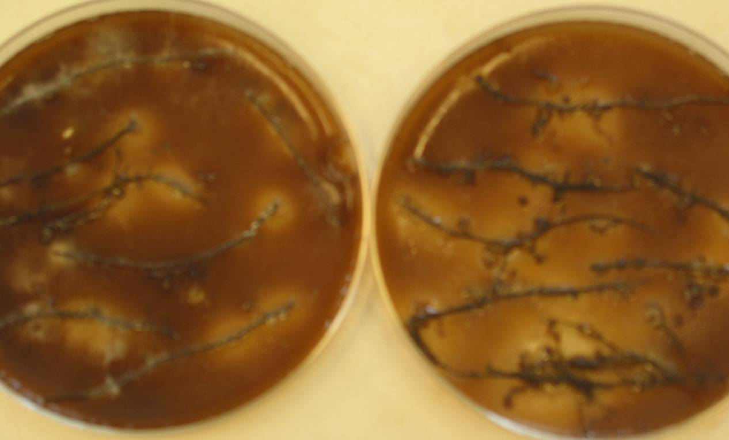
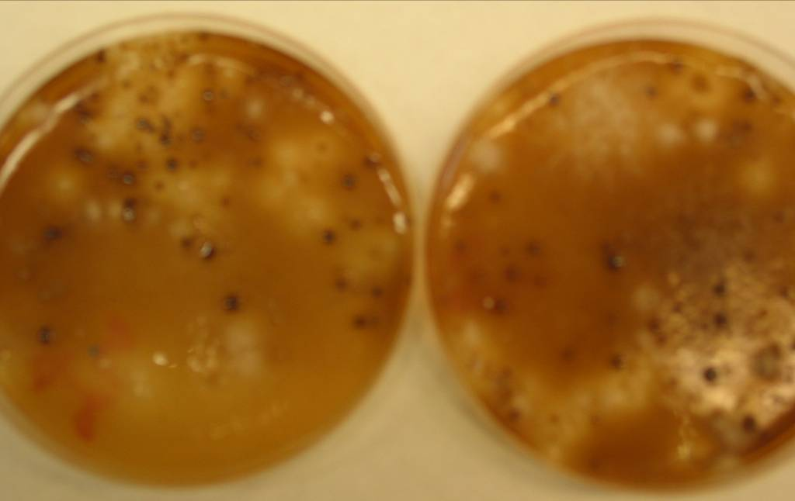
Key Indicator -
Mn transformations primarily microbially-mediated, thus have major impact on plant nutrient availability
Potential Mn-oxidizing (black) & Mn-reducing bacteria (white, clear) and fungi on roots, in rhizosphere soils

Slide 13
Ratio of potential Mn-reducing and Mn-oxidizing bacteria in rhizosphere of soybean-herbicide treatments - Stage V4, 2006
0.33
Higher ratio of Mn-reducers:Mn oxidizers implies higher plant availability of Mn (Rengel. Plant Soil 196:255, 1997)
0.33
0.66
0.51
0.17
W82= ‘Williams 82’; RR 2006=DK-838-52; TM= Conventional herbicide tankmix; RU= Roundup

Slide 14
Ratio of potential Mn-reducing and Mn-oxidizing bacteria in rhizosphere of soybean-herbicide treatments - Stage R2, 2006
0.87
0.61
0.59
0.09
0.67
W82= ‘Williams 82’; RR 2006=DK-838-52; TM= Conventional herbicide tankmix; RU= Roundup

Slide 15
Ratio of potential Mn-reducing and Mn-oxidizing bacteria in rhizosphere of soybean-herbicide treatments - Stage R1, 2007
0.85
Rhizosphere bacteria (cfu x 10^5 /g soil)
0.29
RR variety: Pioneer 93M92

Slide 16


RECALL -
Glyphosate is systemic – the amount not adsorbed to the EPSPS enzyme is transported throughout the plant.
In RR soybean, glyphosate has been found localized in meristematic tissues of growing points, leaves and roots; pod and seed; nodules.
Also glyphosate is actively released through roots into rhizosphere soil (root zone) likely with high amounts of carbohydrates & N-compounds in RR soybean
(Kremer et al. Int. J. Environ. Anal. Chem. 85:1165, 2005)

Slide 17
Cumulative glyphosate release into root exudates
(Kremer et al. Int. J. Environ. Anal. Chem. 85:1165, 2005)

Slide 18
Cumulative carbohydrate released in exudates
(Kremer et al. Int. J. Environ. Anal. Chem. 85:1165, 2005)

Slide 19
Possible metabolic pathways for glyphosate degradation
Glyphosate oxidase reductase (GOX)
+
Aminomethyl phosphonic acid (AMPA)
+
Glyoxalate
GLYPHOSATE
C-P Lyase
+ Acetyl CoA
Glyphosate acetyl transferase (GAT)
+
Sarcosine
+
CO₂
Glyphosate decarboxylase (Gdc) complex
Glycine
Metabolism
Acetylglyphosate (inactivated)

Slide 20
Understanding plant-soil-microbial relationship with GR crops -
Possibilities for nutrient deficiency in plant when soil test indicates sufficient levels
Gly-M
(chelate)
Soil
M^{+n}
Gly
M^{+n}
Gly
Root cell
?
Gly-M
(chelate)
Microbe
Immobilized
M^{1+n}
Ox - immobilized
Root
Soil-Rhizosphere
(Kremer & Means 2009, Johal & Huber 2009, Cakmak et al. 2009

Slide 21
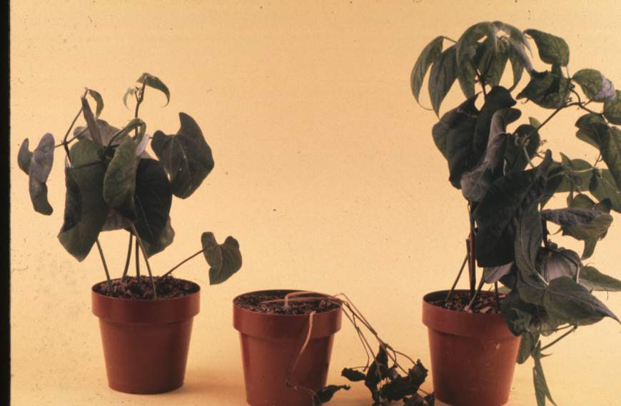
Microbiological Effects -
The “secondary mode of action” of glyphosate
Sterile
Non-sterile
control
Roundup treated plants do not die if grown in a sterile medium, and tend to resume growth over time as the herbicide leaches out or is metabolized.
Johal & Huber 2009

Slide 22
Results on GR crops 1997 - 2010
No consistent trends in population of SDS fungal pathogen
Consistent increases in Fusarium spp. colonizing RR soybean roots with glyphosate applications at label rates
Increased Fusarium colonization attributed to possible lower or altered synthesis of phytoalexins, based on previous work on glyphosate ‘secondary mode of action’ (Johal & Rahe. Phytopathology 74:950, 1984; Levesque & Rahe, Annu. Rev. Phytopathol. 30:579, 1992)
and altered root exudation patterns due to genetic modification or glyphosate interactions in planta (Kremer et al. Int. J. Environ. Anal. Chem. 85:1165, 2005)
These findings might partially explain occasional production problems with RR soybean experienced by many farmers in midwestern U.S.

Slide 23
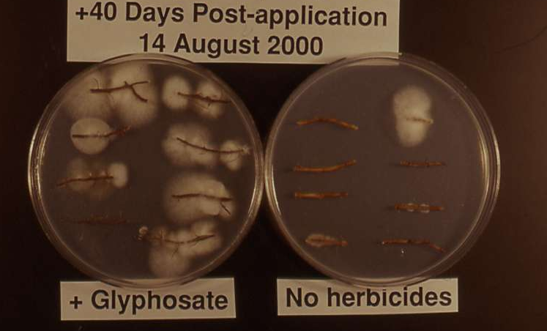
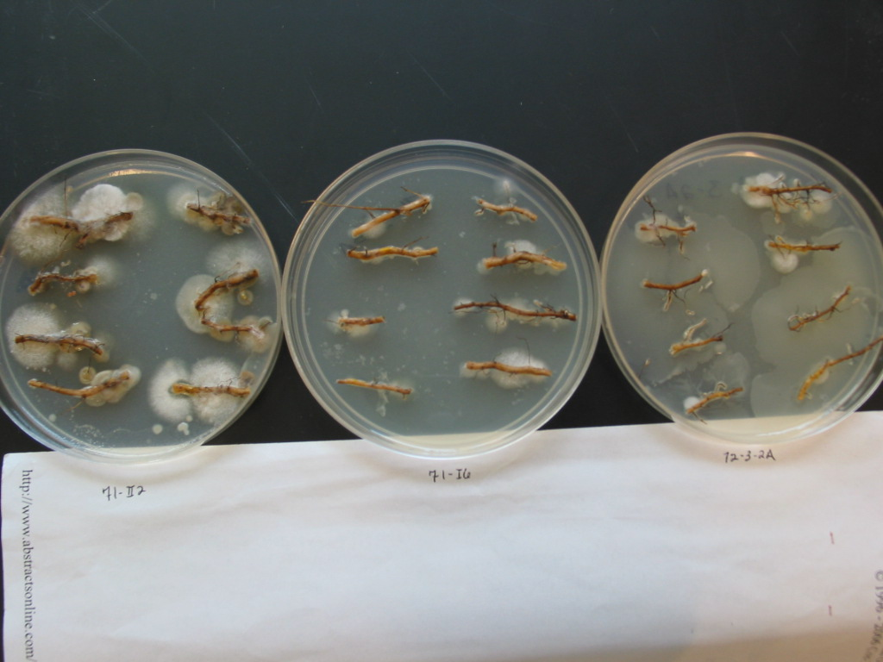
Typical soybean root colonization assay results observed consistently, 1997-2007
Fusarium colonization – 2007 study
+ Glyphosate Check

Slide 24
Typical trend in Fusarium colonization of RR roots
Fusarium colonies per 100 cm root
Kremer & Means 2009

Slide 25
Kremer & Means 2009

Slide 26
Summary - consistent trends over years
Fusarium Root Colonization on RR Soybean 1997-2007
Kremer & Means 2009

Slide 27
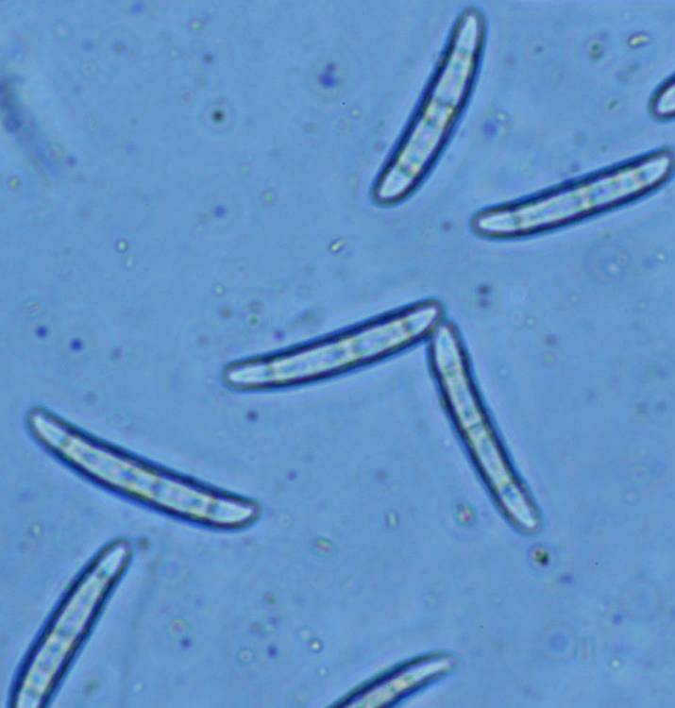
Identification of Root Fusarium Isolates
Subculture, characterize based on cultural and microscopic morphology; key based on Nelson et al. (1983)
Verified via nuclear DNA translation elongation factor sequence primer and Penn State database (Skovgaard et al. (2001)*
Identifications Over All Treatments:
Fusarium oxysporum complex – 72%
Fusarium solani complex – 18%
Fusarium equiseti – 9%
*Analyses conducted at ARS Mycology Lab,
Peoria, IL by Kerry O’Donnell, 2004
F. solani fsp glycines conidia
Photo: D. Sasseville

Slide 28
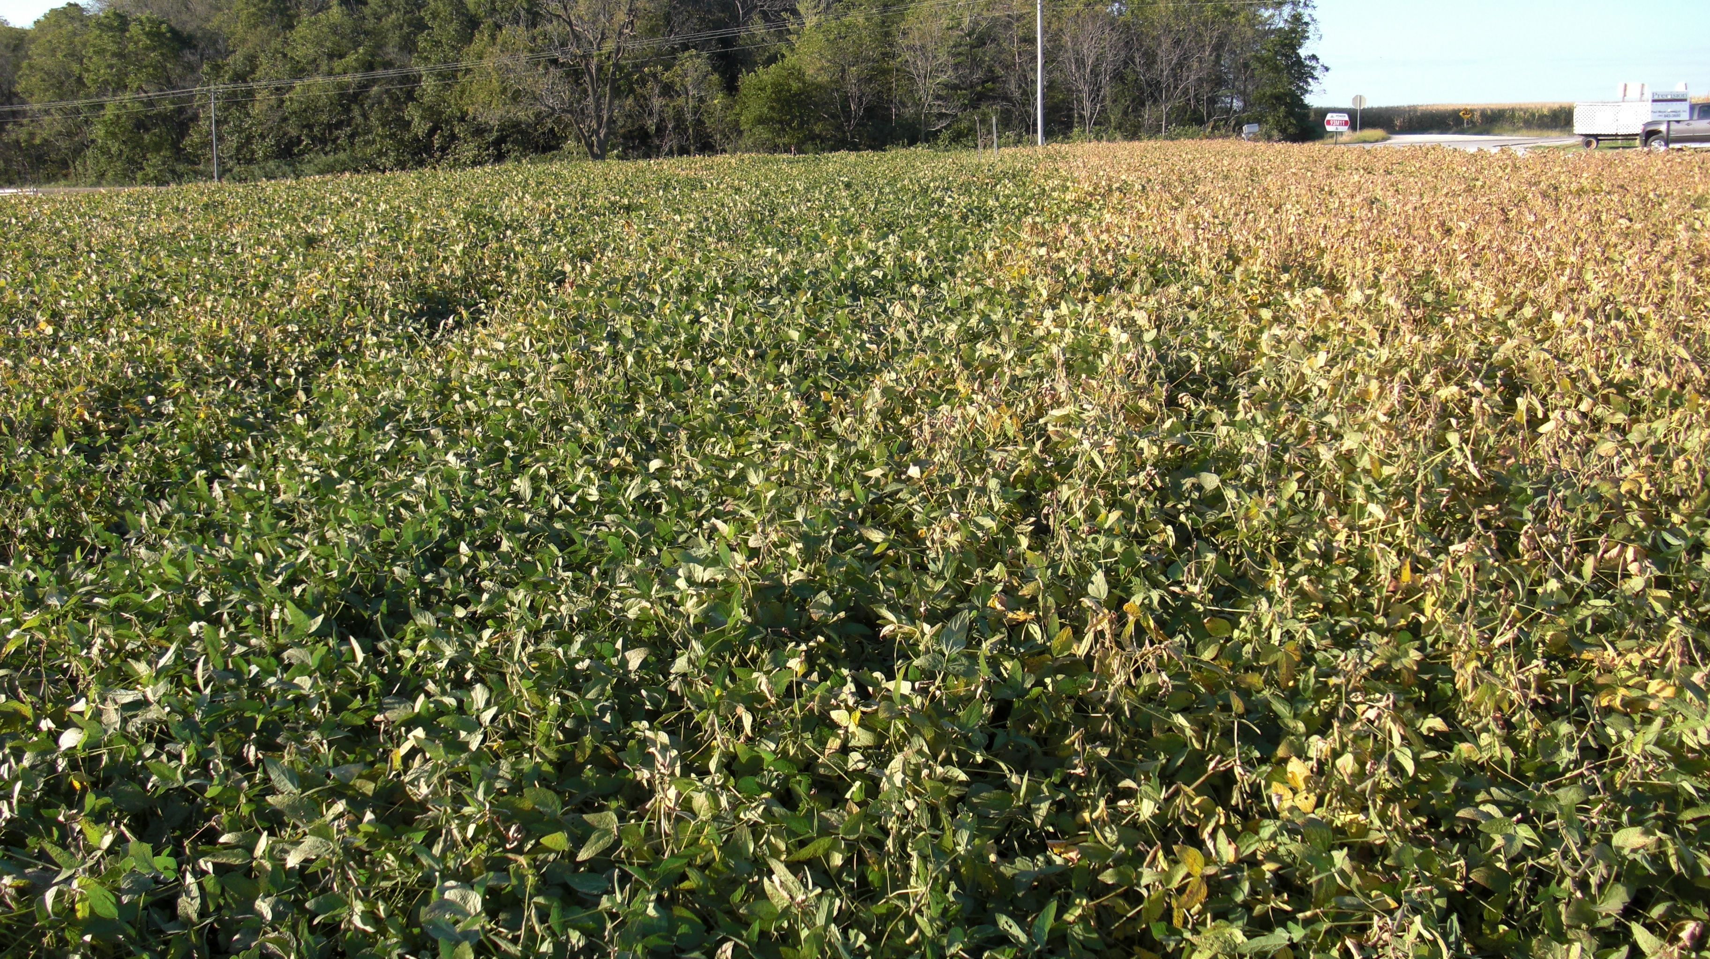
Sudden death syndrome (SDS) in Iowa field, 2010. Section on R comprised soybean planted after glyphosate-killed alfalfa in fall 2009; section on L received no burndown
Photo: D. Huber

Slide 29
Fusarium shown to be good indicator of potential impacts of GM crop on rhizosphere ecosystem – most can be opportunistic pathogens if not directly infectious, and respond to various factors and alterations in the rhizosphere
However, the rhizosphere is a COMPLEX system – a more comprehensive examination of Structure and Function of microbial communities needed to provide a complete assessment of potential effects induced by GM cropping – This will yield better understanding of mechanisms contributing to impacts of GM on soil ecology/biology AND crop productivity.

Slide 30
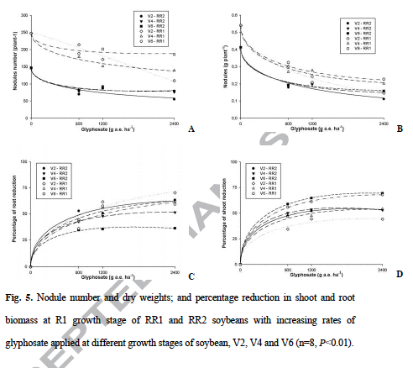
Potential impact of glyphosate on nodulation, nitrogen fixation in soybean. Data collected on greenhouse-grown soybean, 2009. Zobiole et al. 2010

Slide 31
Variety and Herbicide Effects on Soybean Nodule Mass
2005 Field Study, R1 Growth Stage – Mid-Missouri USA
Roundup Ready*
Williams 82
LSD(0.05)
*DeKalb DKB38-52
RU=Roundup; TM=Tankmix conventional herbicide;
HW=Handweeded check
Nodulation generally lower on RR regardless of treatment
Does glyphosate interfere with flavonoid signals required for rhizobia attachment to root?
Impact on PGR substances?
Kremer & Means 2009
Recent report of alteration of rhizobial cell structure by glyphosate in de Maria et al. Appl. Environ. Microbiol. 73:5075, 2007

Slide 32
Glyphosate Effects on Soybean Nodule and Root Mass
2007 Field Study, R2 Growth Stage – Mid-Missouri USA
(similar to 2006 results)
RR variety: Pioneer 93M92
Root mass can be decreased by Fusarium infection (Agrios, 1988)
Kremer & Means 2009

Slide 33
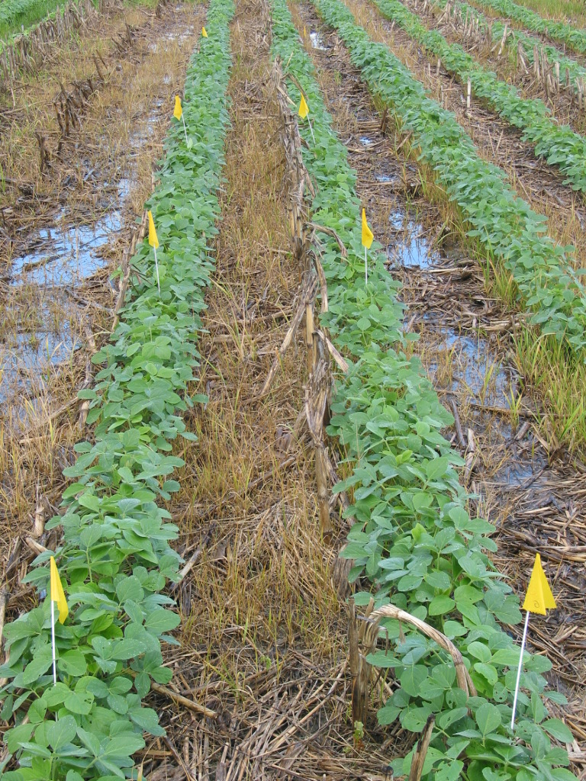
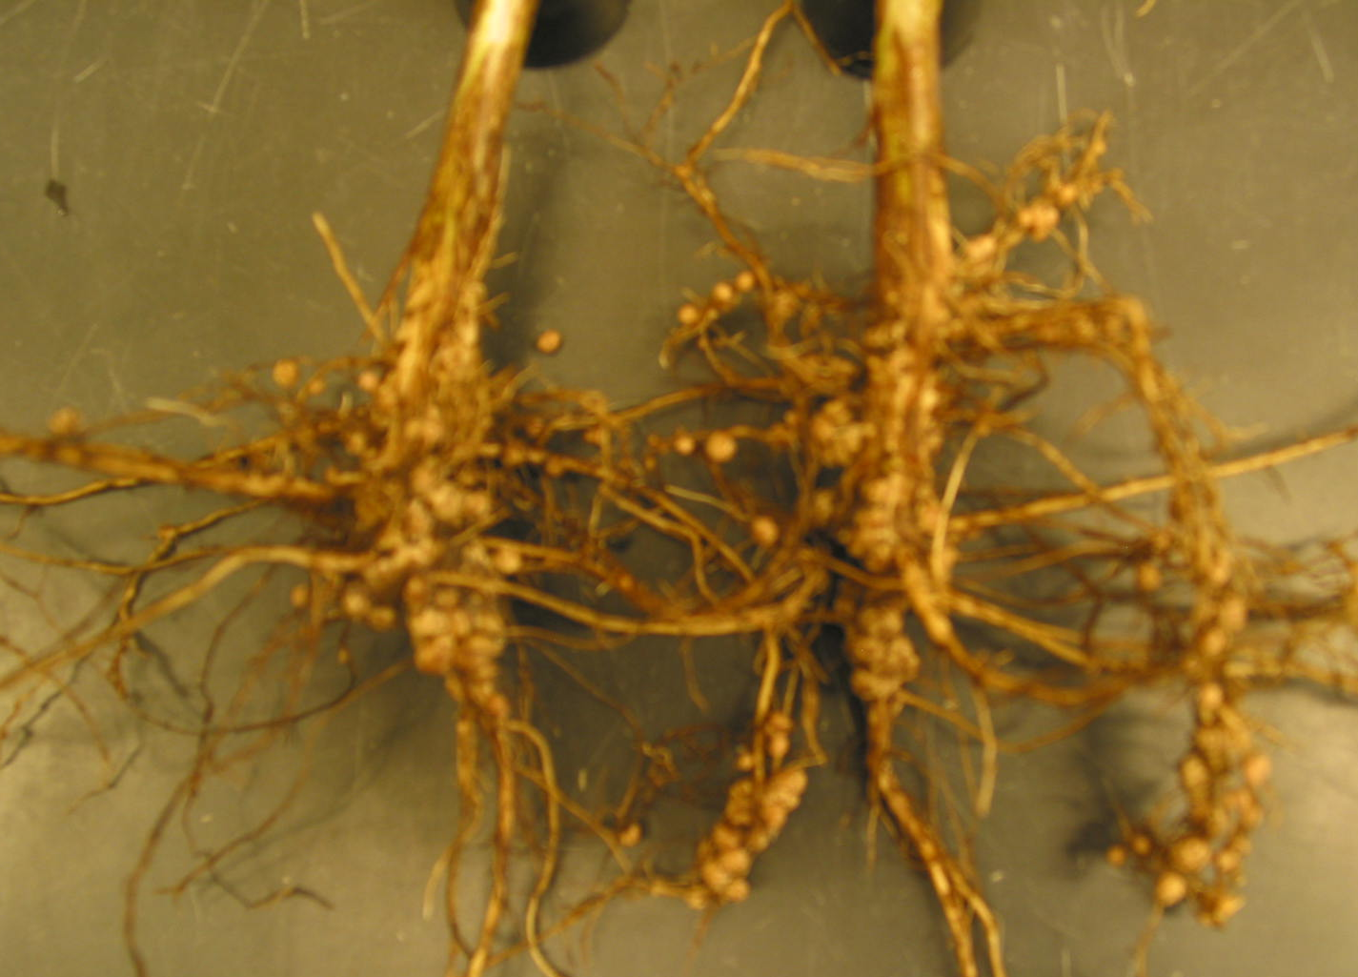
Field conditions (no-till) during 2010 growing season, Boone County, MO
Soybean nodulation at R1, 2010

Slide 34
Soybean nodulation measured at R1 growth stage 2010 (Asgrow AG3539; Maverick)
Nodule mass (mg/plant)
Soils wet to saturated June-September; increased nodulation without glyphosate enough to overcome available N lost thru potential denitrification and contribute to yield increase?
Conventional variety (Maverick) seems better disposed to nodulation than GR variety – possible Bradyrhizobium strain X variety specificity – is strain selection feasible?

Slide 35
Marker G1 G1 N2 N2 N3 N3 N3 G2 G2 G2 G2 G3 G3 G3 Bulk soil Marker
Figure 3. Bacterial community profiles in soybean rhizosphere soils revealed by PCR-DGGE analysis. Samples from soybean cv ‘DK3852’ field-grown in Mexico silt loam. ‘G’ = glyphosate applied at labe rate; ‘N’ = no glyphosate; ‘1-3’ = sample times at V4, V6, R3 growth stages, respectively. Arrows indicate alignment of bands in samples coincide with Bradyrhizobium japonicum represented in the bacterial reference marker lane. Note Bradyrhizobium japonicum bands are faintest in root-free, bulk soil.
Marker G1 G1 N2 N2 N2 N3 N3 N3 G2 G2 G2 G3 G3 G3 -Bulk Soil- Marker

Slide 36
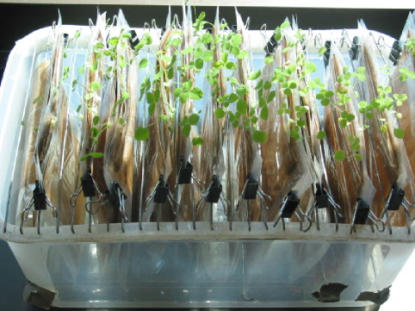
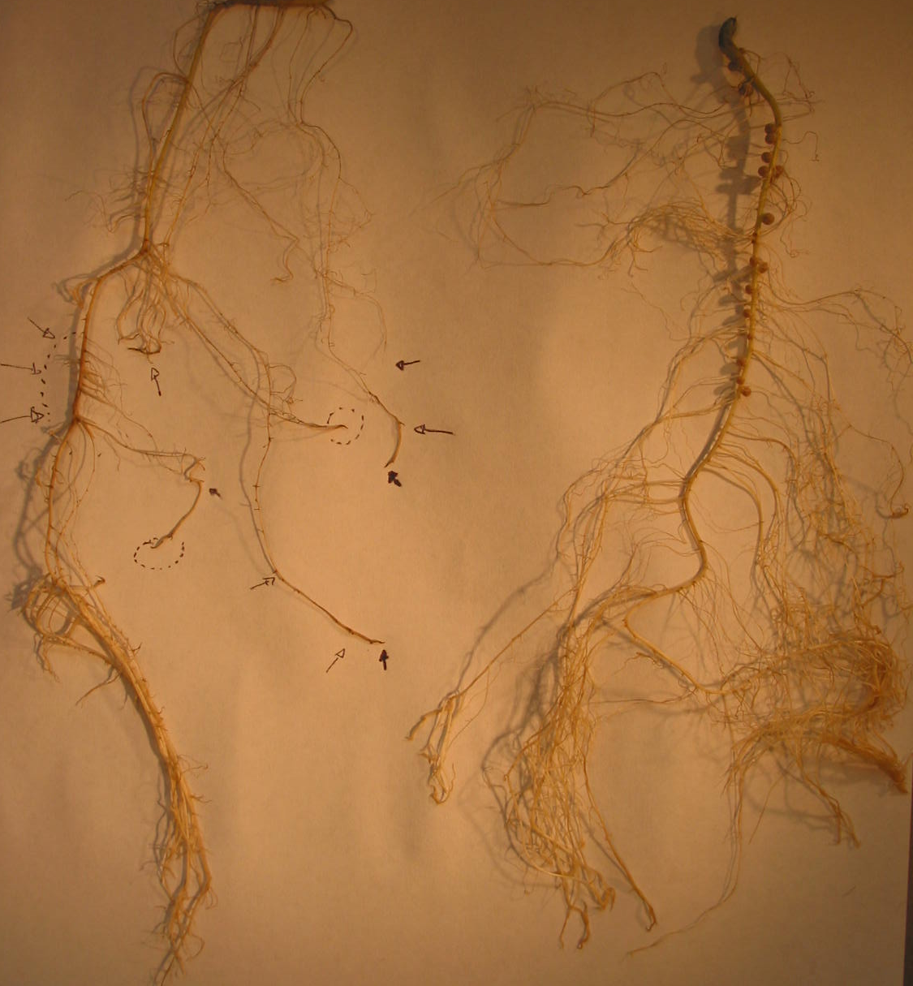
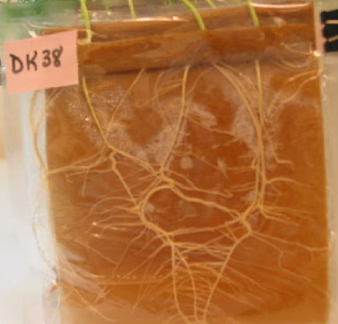
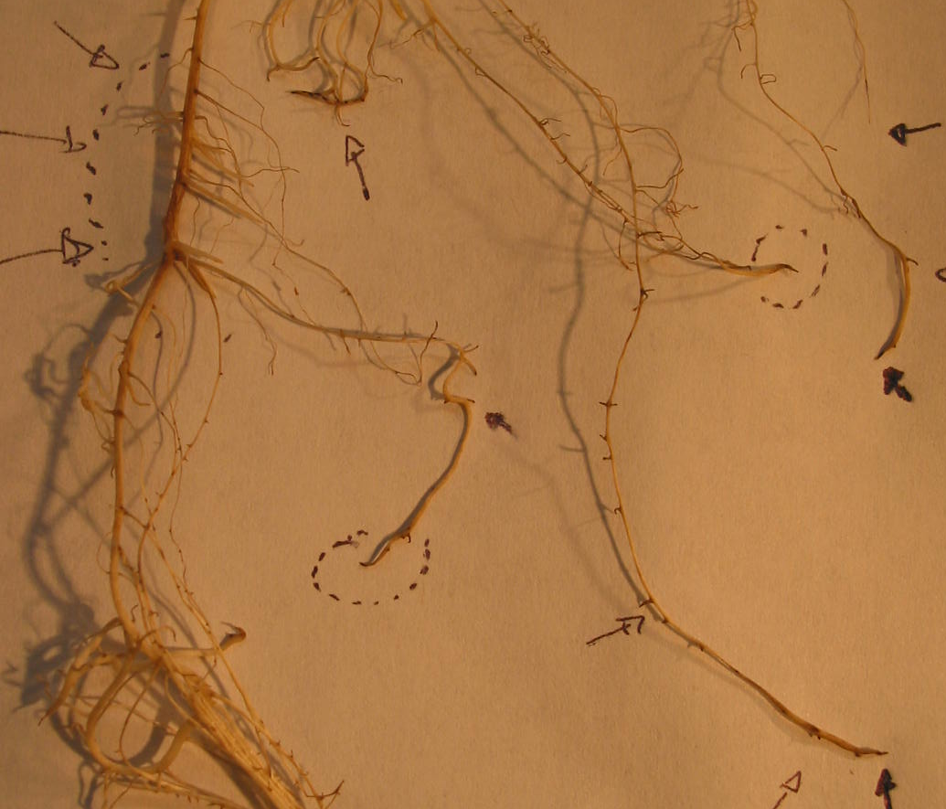
Hydroponic system for collecting root exudates
Figure 5. Root development of 28-day-old GR soybean in growth pouch system. A. Root on Right from plant with no glyphosate, note abundant nodulation; root on Left from plant receiving glyphosate, note stunting and reduced nodulation. B. Root growth abnormalities associated with glyphosate treatment. Note: Blackened root tips and stunted root growth, suppressed nodulation.
Kremer et al. 2005

Slide 37
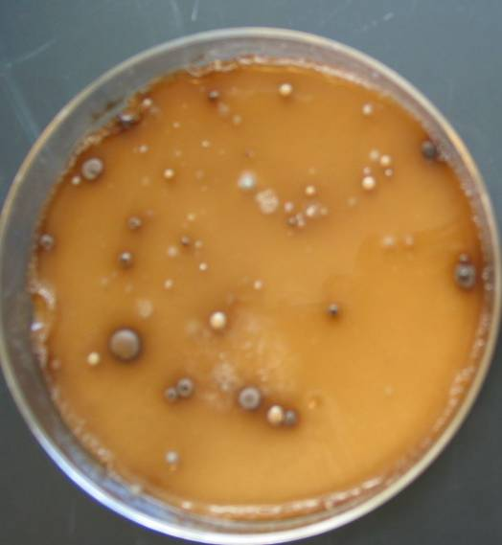
Other interactions of glyphosate with GR soybean rhizosphere microorganisms
Secondary Observation: majority of bacterial colonies with Mn-oxidizing activity also produce copious amount of exopolysaccharides (EPS); very frequently observed with RR+RU; most colonies classified as Agrobacterium spp.; Suggests formation of ‘biofilms’ on roots -- What is relationship between Agrobacterium, biofilms, and glyphosate?
Agrobacterium sp. colony with presumed Mn-oxidizing ability showing excess EPS
Kremer & Means 2009

Slide 38
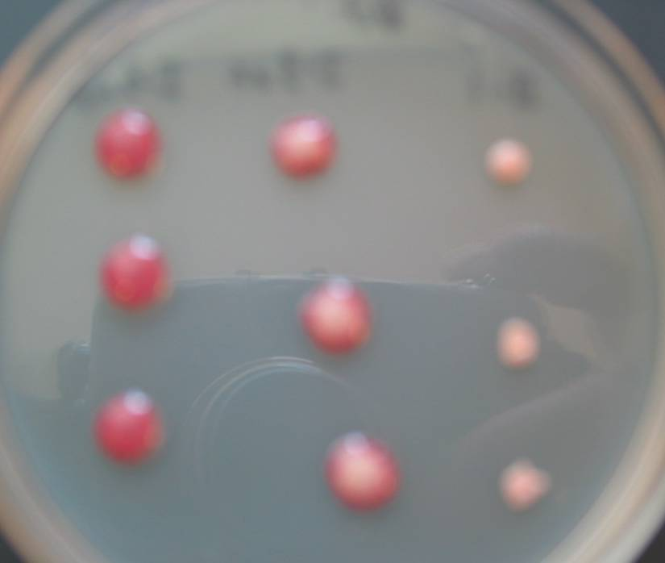
Biofilm - microbes attached to surface (rhizoplane), aggregated in polymeric matrix (EPS); concentrates extracellular enzymes; mediates many functions (Jass et al., 2002),
Including Mn oxidation - in which Mn oxides are precipitated and retained (Toner et al. Appl. Environ. Microbiol. 71:1300, 2005)
Is biogenic Mn oxidation within biofilms enhanced on RR soybean with or without glyphosate amendment??
Demonstration of EPS production by Agrobacterium cultures

Slide 39
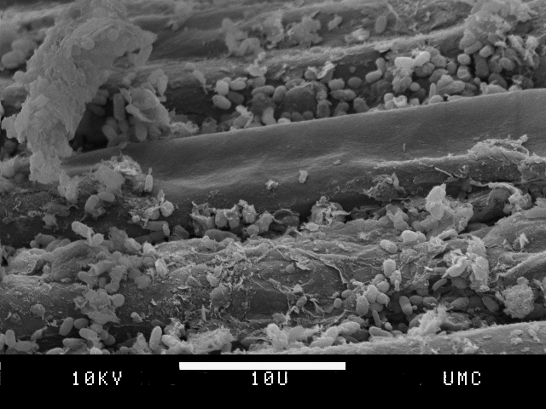
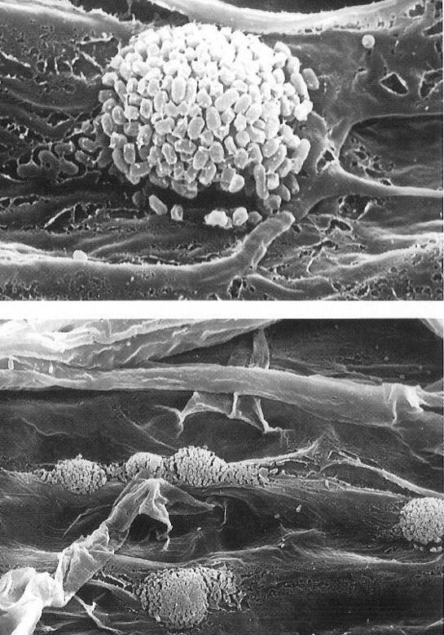
Rhizosphere bacteria on plant root surfaces as BIOFILMS
Role of rhizosphere bacteria on GM crop growth?
Bacterial aggregates in layer of EPS forming biofilm

Slide 40
KEY GROUP: Rhizosphere Pseudomonads
Important multi-functional bacterial group in rhizosphere community (Schroth et al. Prokaryotes 6:714, 2006)
Many fluorescent pseudomonads associated with antagonism of fungal pathogens (Schroth & Hancock. Science 216:1376, 1982) and Mn transformations (Rengel, 1997)

Slide 41
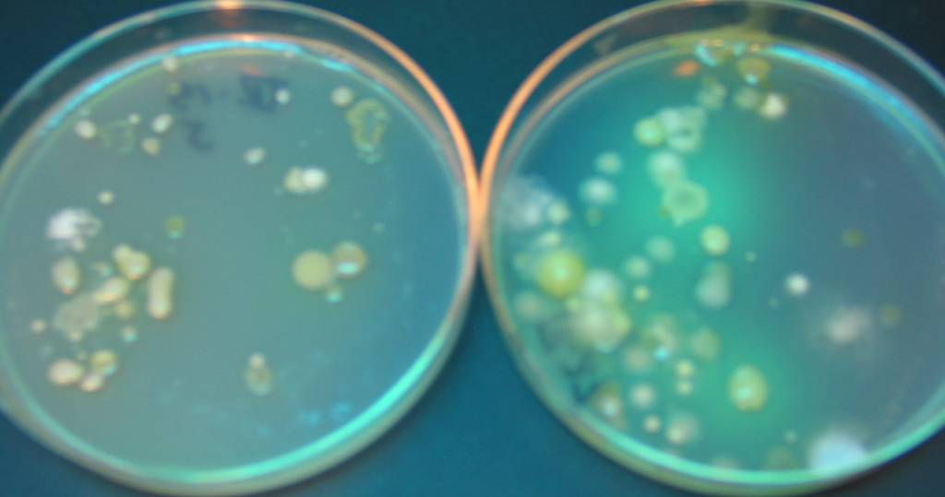
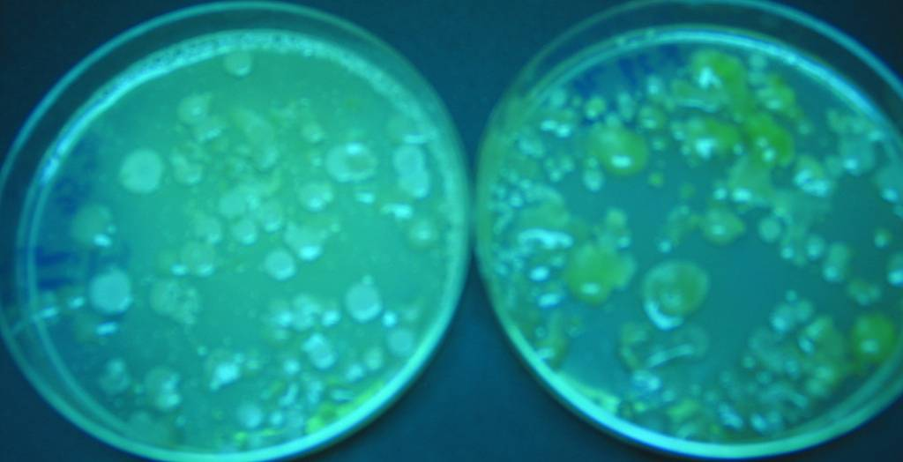
RR+TM W82+HW
Fluorescent pseudomonad colonies visualized under UV light.
W82+TM RR+RU
Relative proportion or composition of Pseudomonas spp. altered in RR or RR+RU treatments. Does glyphosate alter this component in rhizosphere; does genetically-altered RR plant affect composition?

Slide 42
Populations of fluorescent pseudomonads in rhizospheres of soybean-herbicide treatments - 2006
Kremer & Means 2009
Pseudomonad populations greater in conventional system than RR across growth stages
Rhizosphere bacteria (cfu x 10^5 /g soil)
W82= ‘Williams 82’; RR 2006=DK-838-52; TM= Conventional herbicide tankmix; RU= Roundup

Slide 43
Populations of fluorescent pseudomonads in rhizospheres of Roundup Ready soybean (R1) - 2007
Glyphosate seemed to be associated with greater suppression of fluorescent pseudomonads in 2007 – variety effect?
RR variety: Pioneer 93M92

Slide 44
Relationship between colonization of soybean roots by fluorescent Pseudomonas spp. and by Fusarium spp.
Glyphosate (RU) treatments on RR

Slide 45
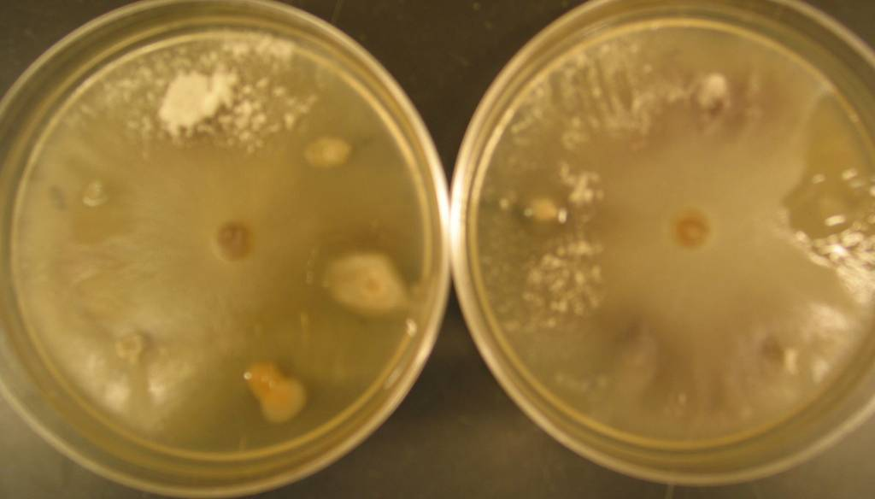
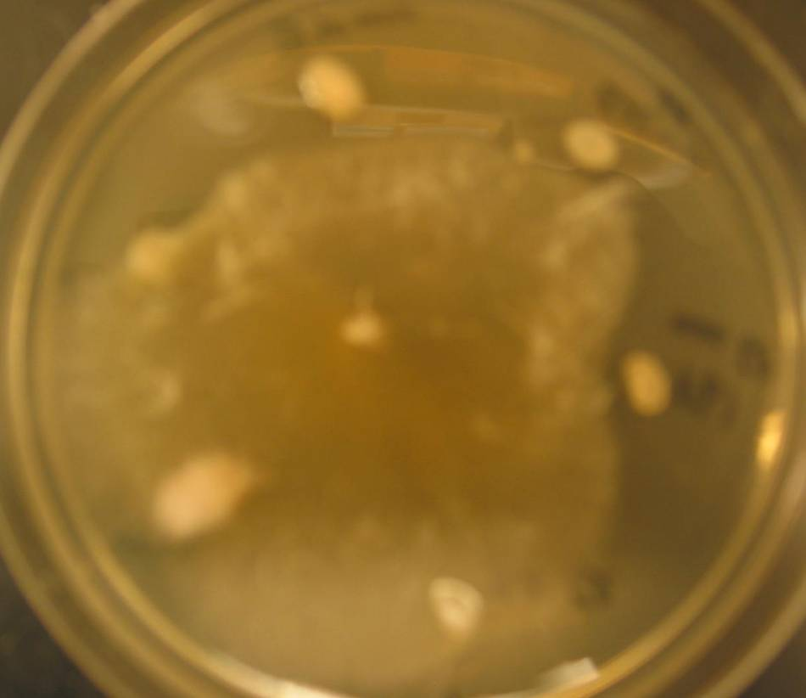
In vitro assays for interactions of rhizosphere bacteria with fungi:
I. Antagonism of Fusarium by bacteria
Fungal growth suppression or conidial germination stimulation by rhizobacterial cultures

Slide 46
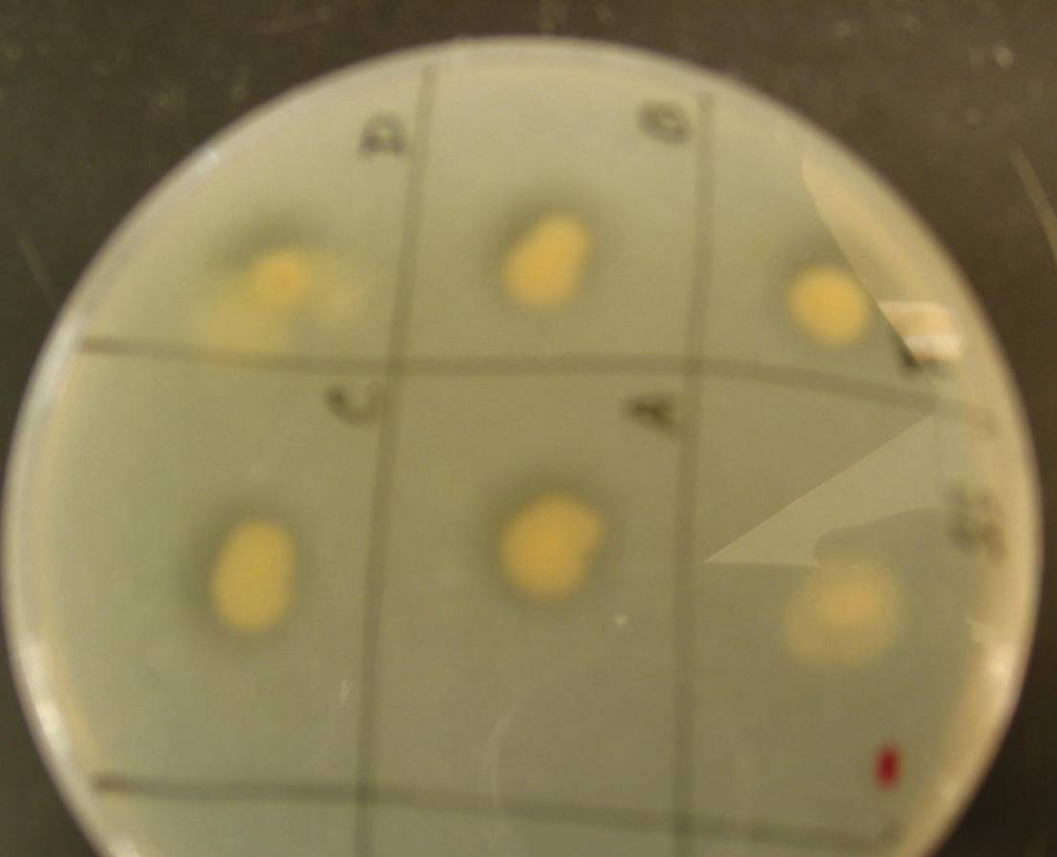
II. Protease assay of selected rhizosphere bacteria on milk protein agar [positive test indicated by clearing around bacterial growth] => possible antagonism mechanism

Slide 47
Characteristics of Some Rhizosphere Bacteria Cultured from Soybean, 2006-2007
Fusarium Suppression
Bacterium
Source
Fluor
EPS
Mn
Protease
Pseudomonas | W82+HW | + | - | Red | + | +
Pseudomonas | W82+HW | + | - | Red | + | -
Pseudomonas | RR+TM | + | + | Red | + | ++
Pseudomonas | W82+TM | + | - | Red | ++ | ++
Pseudomonas | RR+RU | + | ++ | Ox | - | -
Pseudomonas | RR+RU | - | - | Red | ± | -
Pseudomonas | RR+HW | + | - | Red | + | -
Chryseobacterium | RR+HW | - | - | Red | ++ | ±
Agrobacterium | RR+RU | - | ++ | Ox | - | -
Agrobacterium | RR+RU | - | + | Ox | - | -
Agrobacterium | RR+RU | - | + | Ox | - | -
Agrobacterium | RR+RU | - | + | Ox | - | -
Agrobacterium | RR+RU | - | ++ | Red | - | ±
Agrobacterium | W82+HW | - | + | Red | + | -
Fluor=Fluorescence; EPS=Exopolysaccharide
Mn reduction greater factor in fungal suppression than enzymatic process or antibiosis in conventional system? Suggested by Huber & McCay-Buis, 1993

Slide 48
Linking Function to Structure – Molecular Fingerprint of Microbial Communities
PCR-DGGE of bacterial DNA extracted from soybean rhizosphere and bulk soils
Pseudomonas
marker
Agrobacterium
marker
Soil - 2006
W82
R3
2006
W82
V4
2006
RR
2007
RR
2006
RR
2006

Slide 49
Roundup Application (systemic movement of glyphosate to roots)
Complexity of the soil & rhizosphere ecosystem confounded by RR technology
Soybean root
Beneficial (i.e., biocontrol) or Pathogenic (i.e., SDS agent)??
High carbohydrate contents
Rhizosphere bacteria interactions with fungi
Glyphosate
Fusarium spp.
Bradyrhizobia, nodulation interactions?
Mycotoxins
Microbial
Biofilms
Mn, Fe oxidation / reduction
Factors affecting interaction:
Soil moisture/temperature
Clay mineralogy/soil type
Soil organic matter content
RR soybean variety
Soil nutrient status -i.e., Mn
Management - crop rotation, tillage
Enzymes, Toxins
PGPRs (auxins)
antagonisms
Mycorrhizal
Interactions

Slide 50
What is impact of altered plant-microorganism interactions on YIELD?
* Often little impact on yield *
Possible effect on potential for higher yields?
Possible greater expression of detrimental effects under sub-optimal environmental conditions?
Predisposition of soil ecology for more serious impacts in future?
If attention to all factors involved in crop production (total nutrition, soil management, varietal selection, biotic interactions), perhaps begin to approach Kip Cullers-type yields.
Soybean Yield (bu/A)
Cultivars:
2006 – Pioneer 93M90; Williams 82
2007 – Pioneer 93M92
2008 – DeKalb DK3852; Maverick
2010 – Asgrow AG3539; Maverick
Data shown from field trials in Boone County, MO.

Slide 51
IMPACT OF RESEARCH – “in a word” – MANAGEMENT
Complete nutrient management program; monitor base saturation – level of available Ca is critical
Foliar treatments for single nutrient often insufficient if others are deficient
Foliar amendments with biologicals may limit expected yield losses in short term (single season)
Plant-growth regulators, amino acids, soluble Ca may limit perceived adverse effects of glyphosate, pathogens
Seek sources of complete fertilizer nutrients:
Ex: Poultry litter contains considerable amount of:
P, K, Ca, Mg, S, Fe, Mn, Zn, Cu, B, Mo

Slide 52
Salicylate, a precursor of plant-defense compounds, applied as foliar treatment suppressed colonization of soybean roots in field study, 2007
+ Glyphosate Check Glyphosate +Salicylate

Slide 53
REFERENCES
To be furnished on day of presentation

